Slide 1
Producing a Successful Business
Web Site
Lecture 4

Slide 2
Writing a Request for Proposal (RFP)
?

Slide 3
Incorporate your business goals and objectives, your list of competitors, and your target audience on your request for proposal (RFP).

Slide 4
Thinking About the Structure of Your Web Site
Using AIDA to guide visitors toward specific actions. The four standard steps of direct marketing (known as AIDA) apply to the structure of Web sites:
✓ Attention:
Get viewers’ attention by using graphics, a headline that grabs, and a benefits-based lead. You have four seconds to convince them they’ll find something of value on the site.
✓ Interest:
Build interest with site design and navigation. Include intriguing options that pull people to additional pages on your Web site, giving you time and space to expose visitors to your products, services, and benefits.
✓ Desire:
Create desire and a sense of urgency as visitors move themselves toward taking an action. If you think visitors are almost ready to buy, post a reminder to Order Now for Free Shipping
  ✓ Action:
  Right from the beginning, make it obvious what you want visitors to do, whether it’s to buy online, make a call, send an e-mail

Slide 5
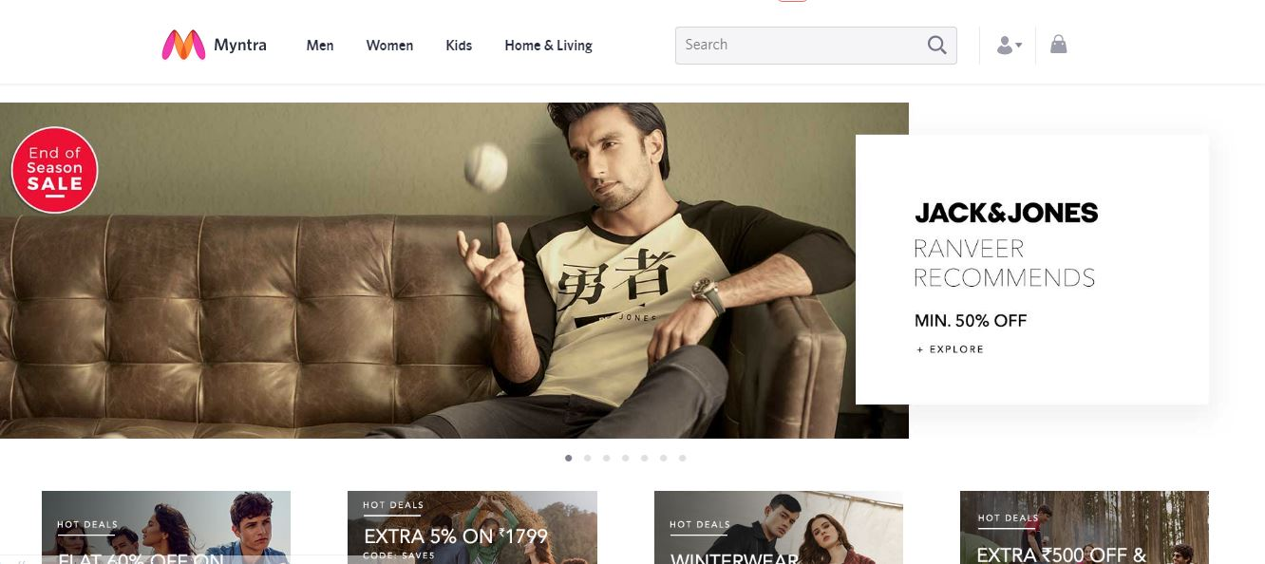

Slide 6
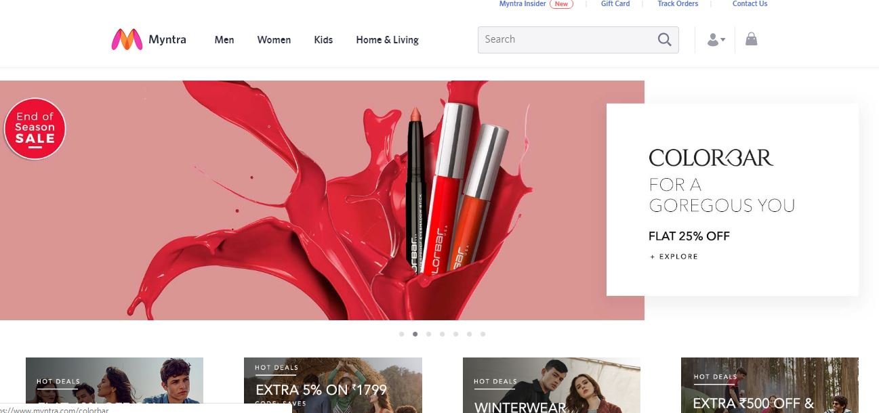

Slide 7
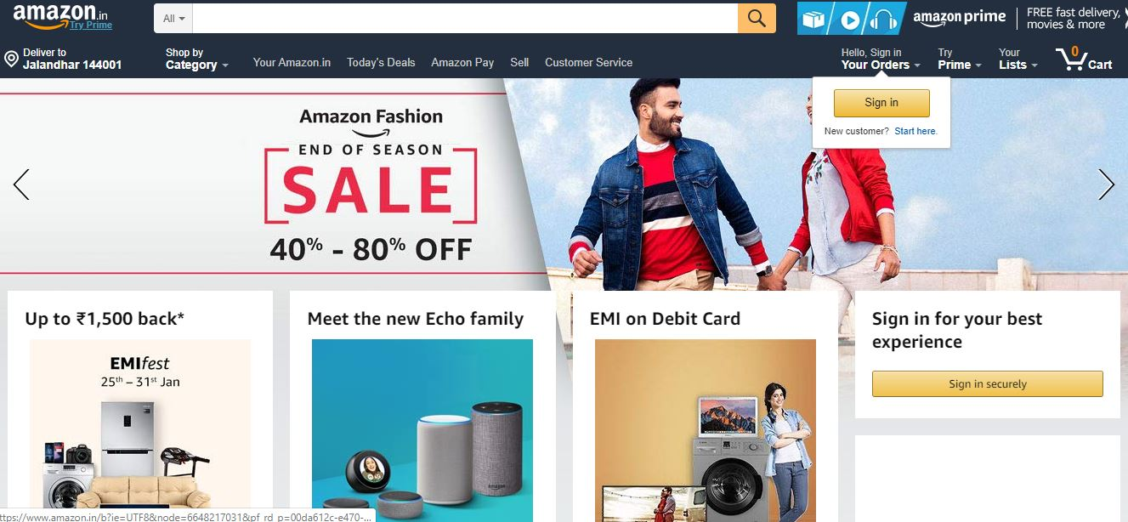

Slide 8
Assessing your Web site or others
While many people use different wording, these five elements cover the
ground of site design:
✓Concept: The underlying design metaphor for your site, intimately connected to your brand and target audience
✓ Content: All the words, products, pictures, audio, interactive features, and any other material you put on your site
✓ Navigation: The way users move through a site by using menus, links, and sitemaps. Sitemaps are an easy way for webmasters to inform search engines about pages on their sites that are available for crawling.
✓ Decoration: All the supporting design elements, such as buttons, fonts, and graphics that your designer creates
✓ Marketing efficacy: Methods such as calls to action or signup forms that get users to do what you want them to do

Slide 9
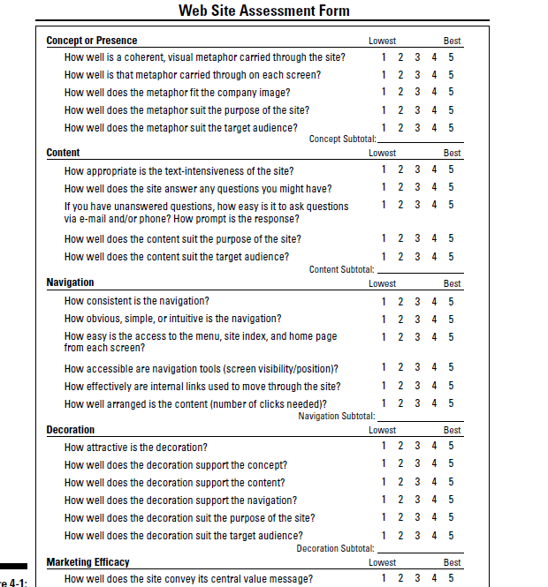

Slide 10
Creating a Concept
AcomaSkyCity.org, a site created by Webb Design, Inc.(www.webbdesigninc.com). A good designer integrates marketing communication principles, branding considerations, and your target audience into the concept for your Web site.
Applying marketing communications principles to your design(Marketing communications integrates marketing and sales principles with graphic design to achieve business objectives. It acknowledges that the presentation of information affects emotional response and thus influences buying decisions. Designers ask about your target audiences to be sure to select or create appropriate design elements

Slide 11
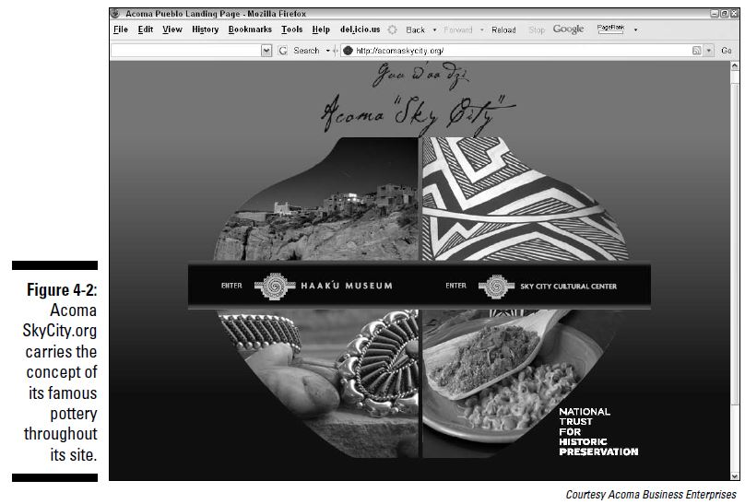

Slide 12
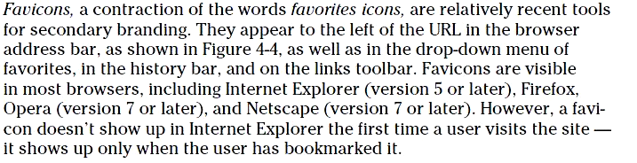
Branding with logos and favicons - LogoMaker.com
Put your company logo on your Web site, just as you would on any other advertising or packaging. It’s an essential part of your brand.
Favicons, a contraction of the words favorites icons, are relatively recent tools for secondary branding

Slide 13
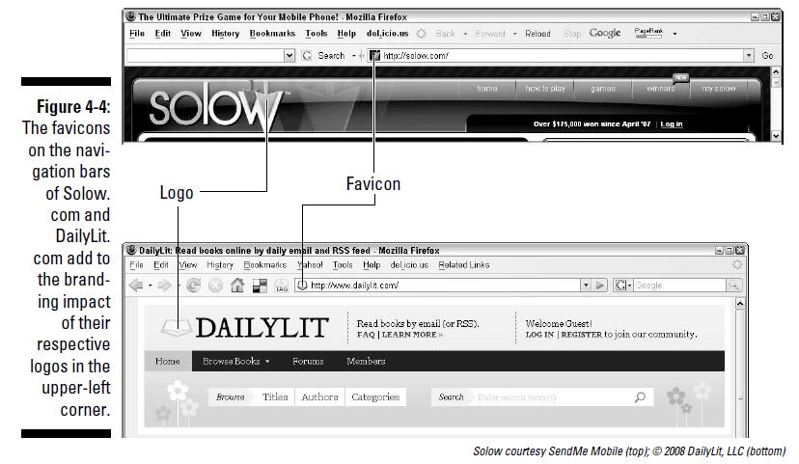

Slide 14
Developing Content
Content refers to everything you provide for the Web site, from written copy to photographs, from product information for a database to a calendar of events.
    A) Writing effective marketing copy
    1) Use the inverted pyramid.(most imp information on first page)
    2) Grab readers with headlines
    3) Write strong leads. The first sentence on the page is called the lead
    4) Avoid long, scrolling pages
    5) Keep it short
    6) Use bullet lists
    7) Include text links.
    8) Check spelling and grammar
Telling stories with pictures(https://soaringcolorado.com/)
Using rich media(Audio clips, music, video, which adds marketing value by explaing a product or service,easier to use(live web cam in day care),to be ahead of competitors)(give them option for controling both video and audio)

Slide 15
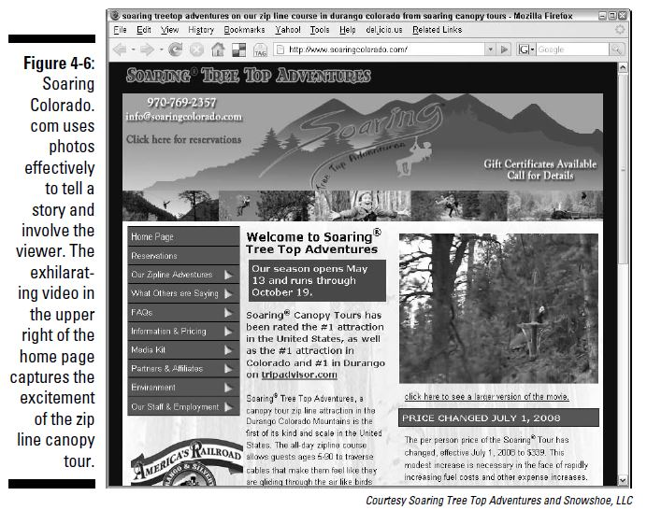

Slide 16
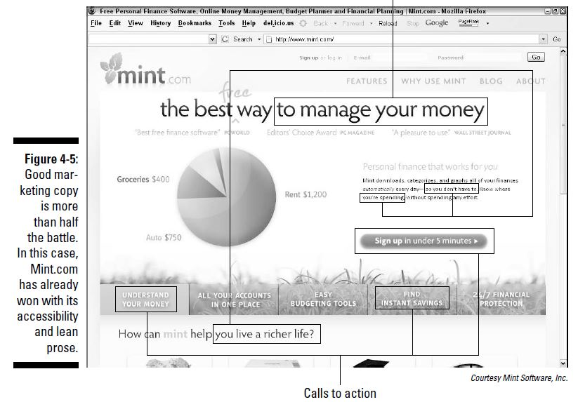

Slide 17
Choosing how to update your content
Have your developer handle the updates
Use an open source CMS. Open source (open source refers to source code that is available to developers to use, modify, and redistribute without charge) CMS software like Drupal, Joomla, and Mambo have many customizable options.

Slide 18
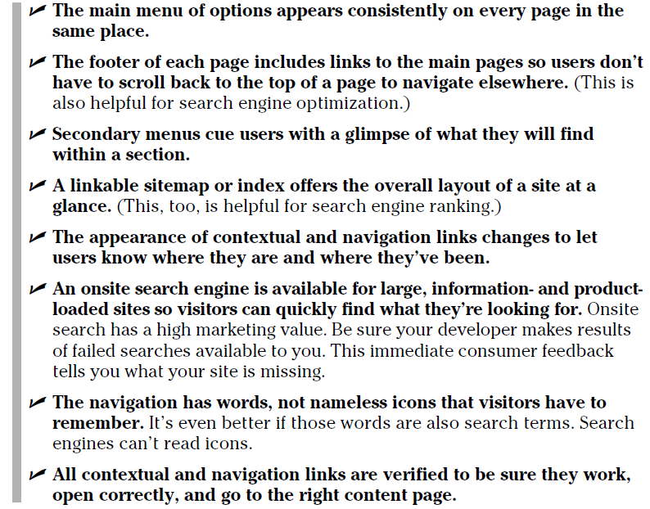
Navigation
Ensuring Easy Navigation: A Human-Friendly( Site(Zopa, a unique social finance network seen in Figure 4-9 (https://us.zopa.com) The bar beneath each item in the horizontal navigation at the top of the screen is color-coded

Slide 19
Mastering usability issues-Test your site on all popular, current browsers and versions for compatibilityand download speed. Slightly more than half of all users run Internet ExplorerVersion 6 or 7; about 43 percent use Firefox; fewer than 5 percent run Safari or Opera.

Slide 20
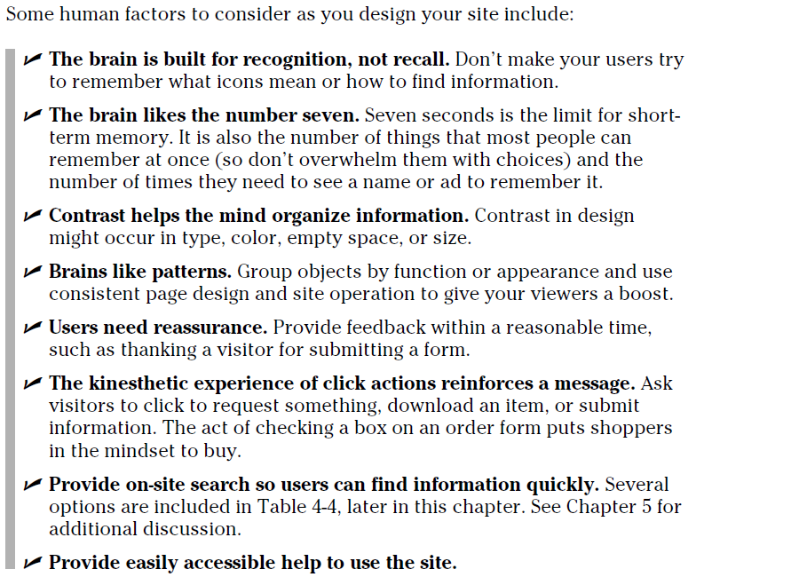
Taking human factors into consideration

Slide 21
Making your site accessible
You must design your site with specific, human factors in mind when your target audience includes children, seniors, or people with disabilities. Accessibility is particularly important for information-intensive sites, social service organizations, political sites, newspapers, and other public communications.

Slide 22
Decorating Your Site
Decoration encompasses colors, buttons, backgrounds, textures, rules, fonts, graphics, illustrations, photos, sounds, and any other elements that support the overall concept.
Using gadgets and widgets(to calculate interest, convert currency,track stock prices, check the weather, display headlines, play games,view a calendar, personalize a play list(install them on your Web site to add value)(http://thunderscientific.com/,water drop icons)

Slide 23
Improving Marketing Efficacy
Marketing efficacy refers to other onsite techniques that encourage users to do what you want them to do.
The conversion funnel
Conversion rate is one of the most important statistics you track for your site. It is the number of people who take a desired action divided by the number of people who visit clicks to action.
Enable users to take the action or action(s)you most want in two clicks or less. Keep your primary calls to action,such as Add to Cart or Sign Up to Save, on the main navigation or catalog pages at all times. A second click submits the request.
With the right phrasing, a link call to action pulls the user to another page with anappeal to self-interest
The four-letter word that starts with F(free) free generates an impulse to act.(https://www.highcountrygardens.com/)

Slide 24
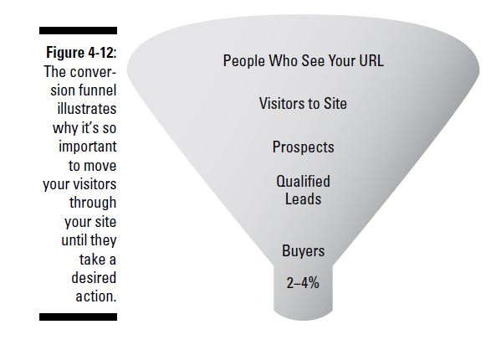

Slide 25
